Slide 1


Games Insight By Gaming Platform
Sarah Casauria
Brandon Lee
David Cheung
Dhiren Patel
Maica Tran

Slide 2
Introduction
Looking at games released by various gaming platform.
Gaining insight to which gaming platform is best suited for them and/or their family.
Hypothesis – Nintendo based platforms will be better suited for young children.
Notes:
As a gamer, I get asked a lot by my non-gaming friends and family on what platform to get for them and/or their family.
During the discovery phase of this project, we stumbled upon a dataset which allowed us to analyse games released by gaming platform.
We created a Web Page where users could see a summary of games released per gaming platform to help them decide which gaming platform is more suitable for them and/or their family.
Our hypothesis is that Nintendo based gaming platform is more suitable for families with young children (based on their marketing campaign).
During this presentation:
David will give you more information about the data;
Dhiren will cover the work flow that we have adopted in creating this website;
Sarah will explain the nuts and bolts that makes this website tick and will give you a demonstration of the website
Maica will summarise our experiences in creating this website as well as cover our overall conclusion.

Slide 3
Data
Data obtained from Kaggle
Data is transformed:
Cleansed (NaN removed);
Summarised data by gaming platform;
Imported into mongoDB atlas

Slide 4
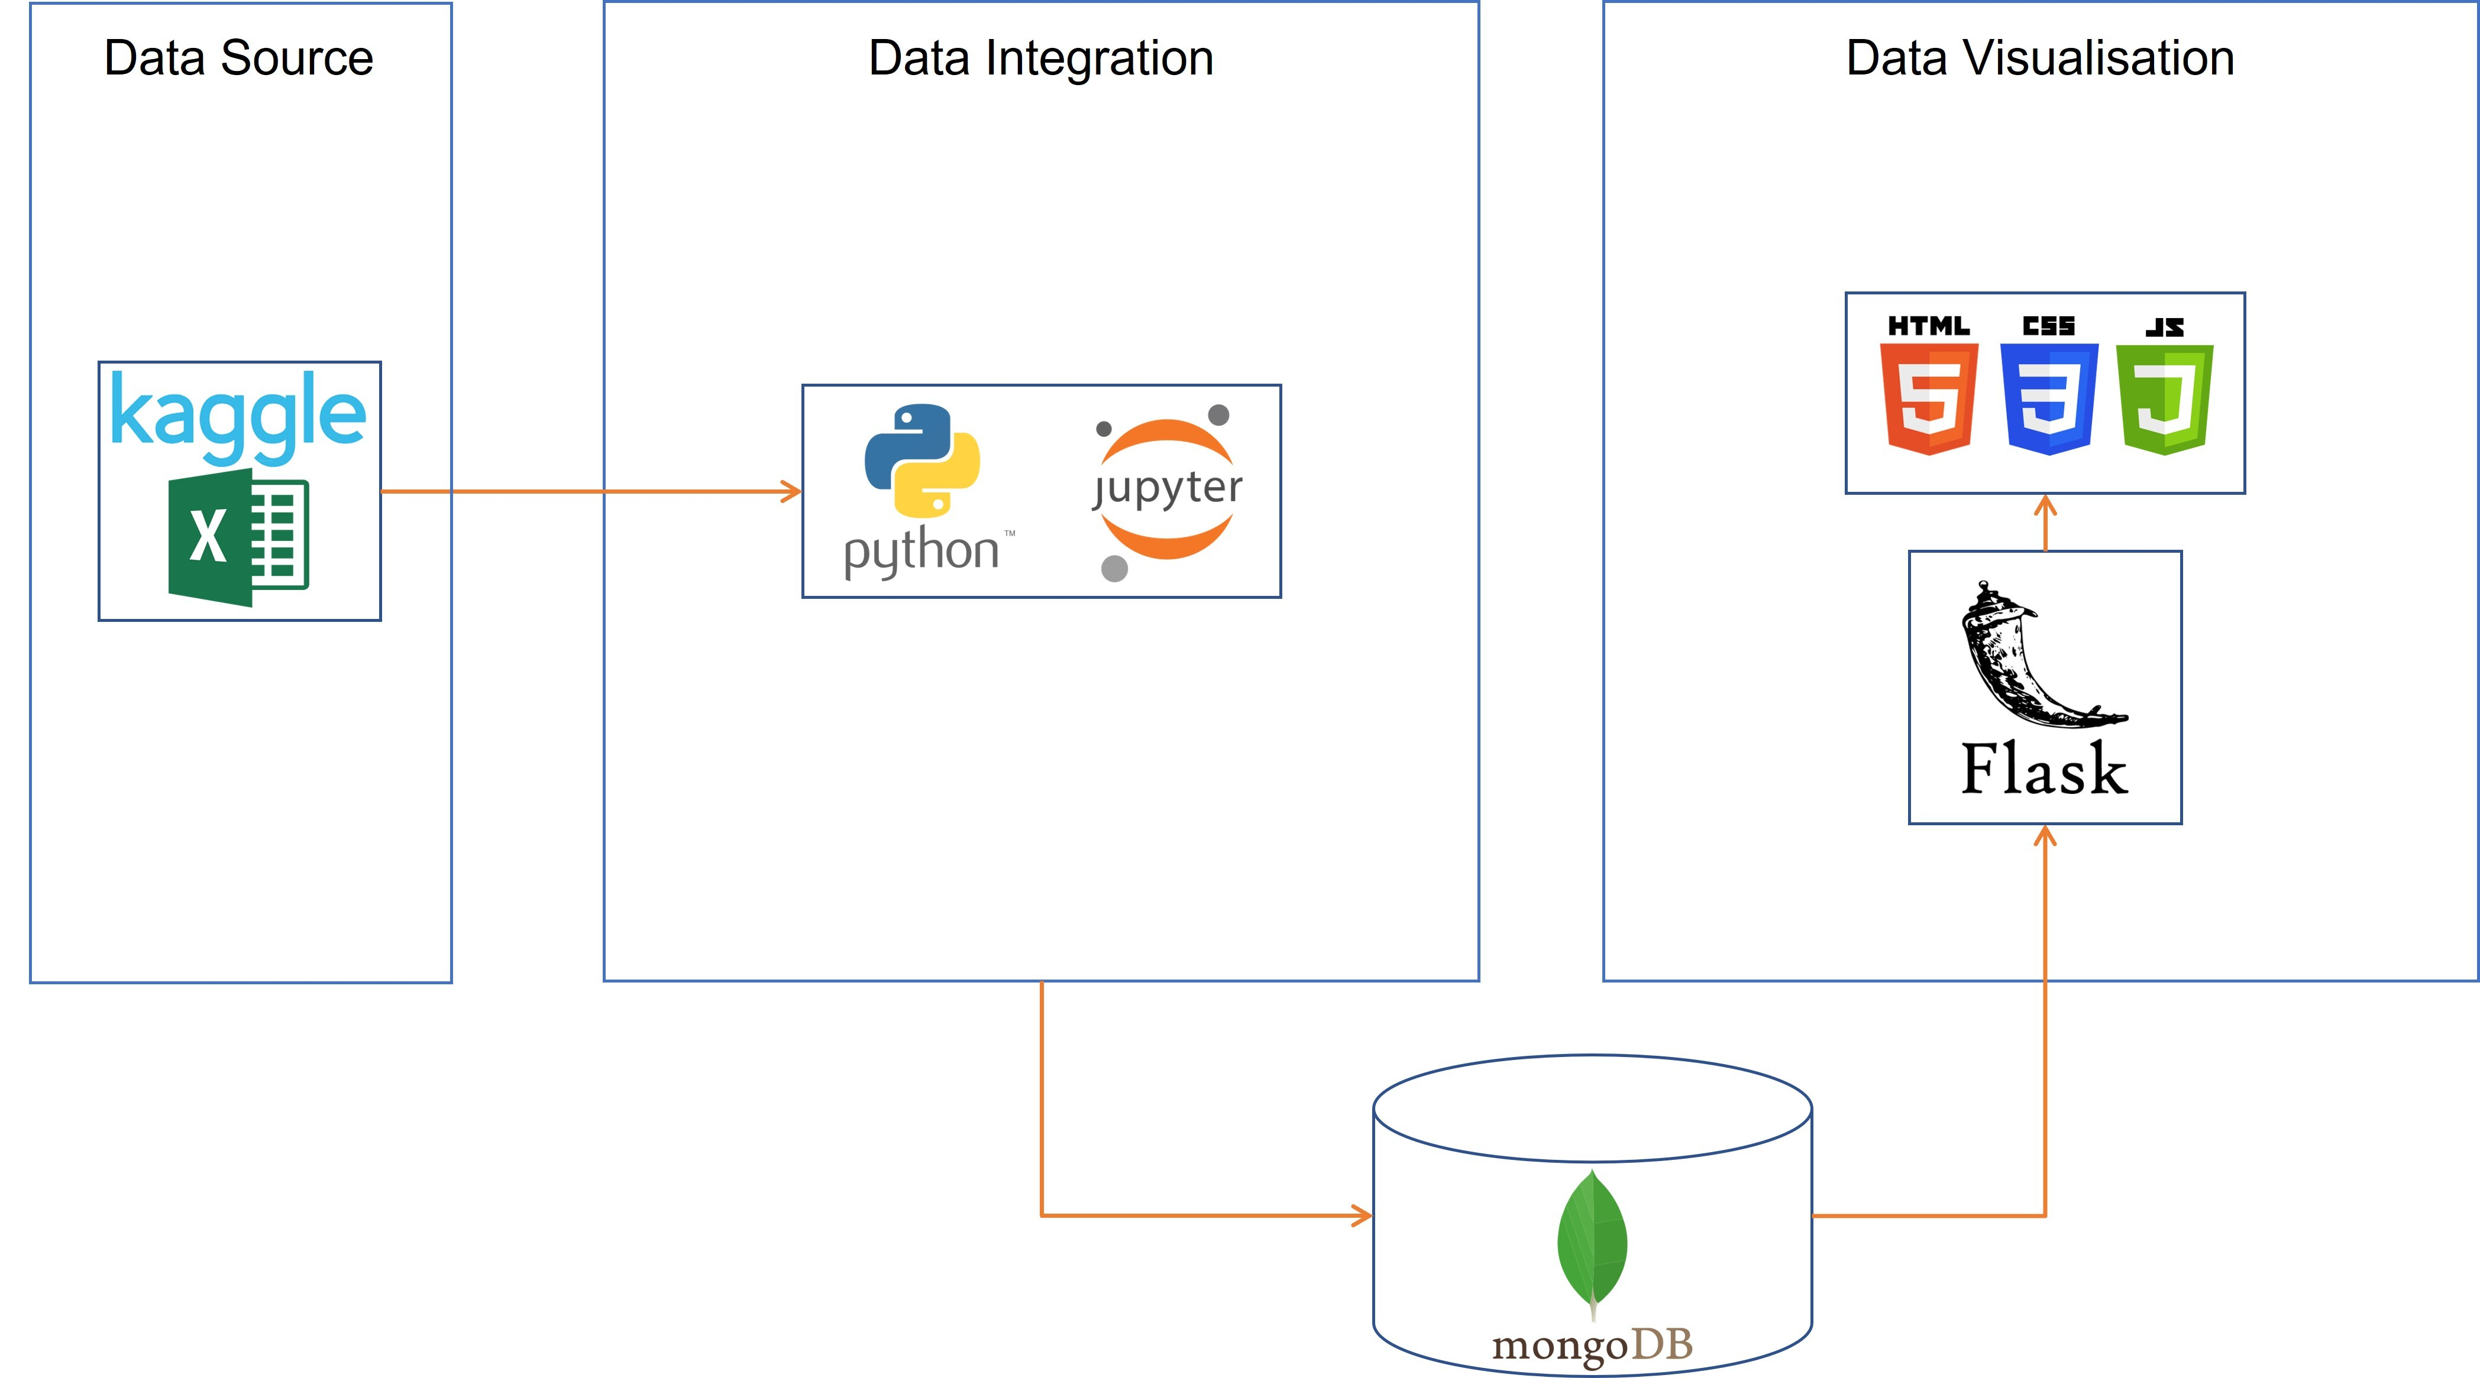
Work Flow Diagram

Slide 5



JavaScript Development
Libraries used:
D3.js
Import JSON data from Flask
Append JSON data to HTML elements
Plotly.js
Create gauge plots for critic and user scores
Chart.js
Create bar plot for average sales by region
Create pie charts for distribution of game ratings and genres

Slide 6
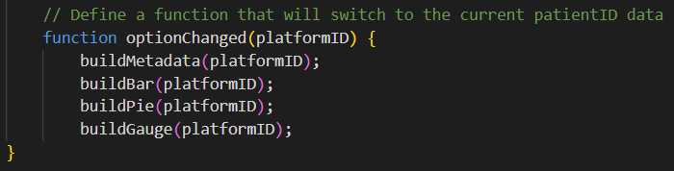
Graphs and Charts Generation
Created six functions:
Initialise visualisations with first platform loaded into dropdown
Build metadata table
Build stacked bar chart for average sales
Build pie charts for distribution of ratings and genres
Build gauge charts for critic and user scores
Upon changing dropdown option, rebuild graphs for selected platform

Slide 7
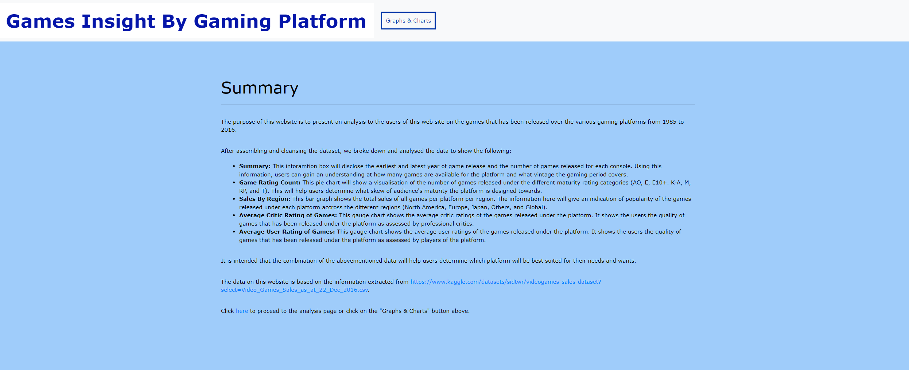
Demo Of Website

Slide 8
Conclusion
The data supports the hypothesis – Nintendo based platform is better suited for young kids.
For adult gamers XBOX One is better suited.
Non Nintendo based Platforms was observed to have a higher frequency of M rated games in modern gaming.
Challenges faced during this project:
Had to use a JavaScript library that was not taught.
Troubleshooting using online research was difficult.
Issues with flask code.
JavaScript was fiddly.

